Slide 1
Time Series 501
Lesson 5: ARMA and ARIMA Models

Slide 2
Learning Objectives
You will be able to do the following:
Review and recall key ideas from previous lessons.
Describe an ARMA model and its stages.
Describe the ARIMA and SARIMA models and choose parameters.
List ARMA, ARIMA, and SARIMA model assumptions.
Use Python* to construct ARMA, ARIMA, and SARIMA models.

Slide 3
ARMA Model

Slide 4
ARMA Model
The ARMA model (also known as the Box-Jenkins approach) combines two models:
An autoregressive model
A moving-average model

Slide 5
ARMA Model Notes
Some things to keep in mind when dealing with ARMA models:
The time series is assumed to be stationary.
A good rule of thumb is to have at least 100 observations when fitting an ARMA model.

Slide 6
ARMA Model Stages
There are three stages in building an ARMA model:
Model identification
Model estimation
Model evaluation

Slide 7
ARMA Model Identification
Confirm the following:
The time series is stationary.
Whether the time series contains a seasonal component.

Slide 8
Determine Seasonality
You can determine whether seasonality is present by using the following:
Autocorrelation plot
Seasonal subseries plot
Spectral plot

Slide 9
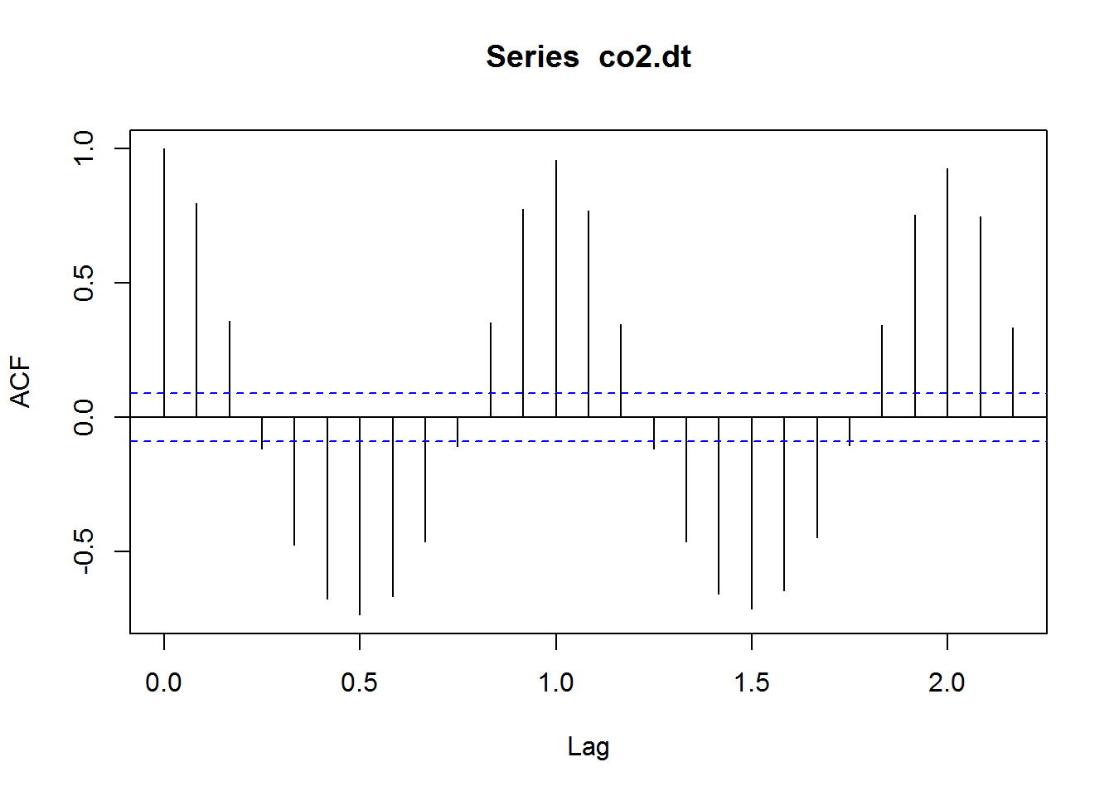
Autocorrelation Plot
Notes:
https://kevintshoemaker.github.io/NRES-746/Time_Series_Lab.html

Slide 10
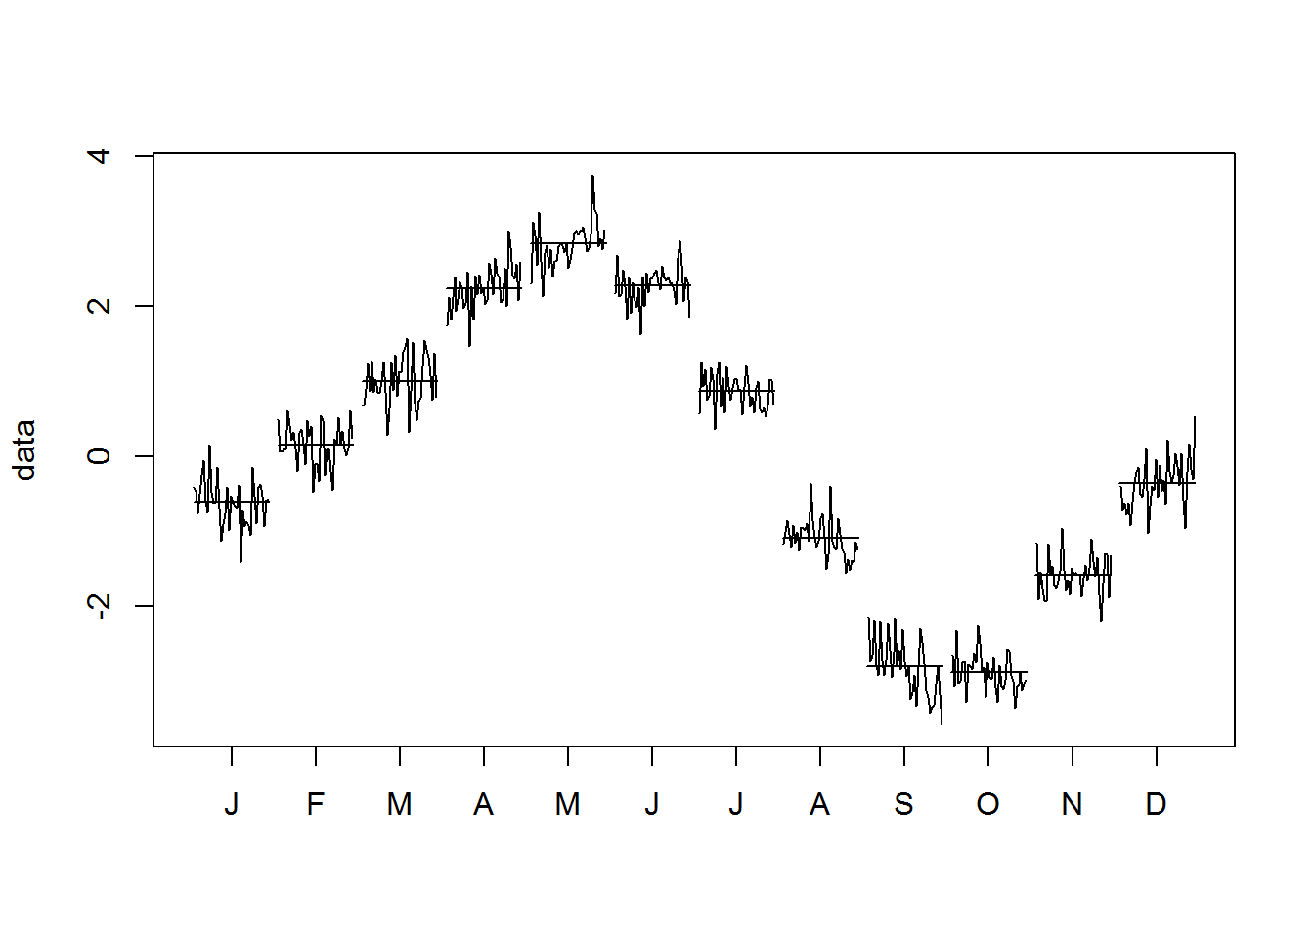
Seasonal Subseries Plot
Notes:
https://kevintshoemaker.github.io/NRES-746/Time_Series_Lab.html

Slide 11
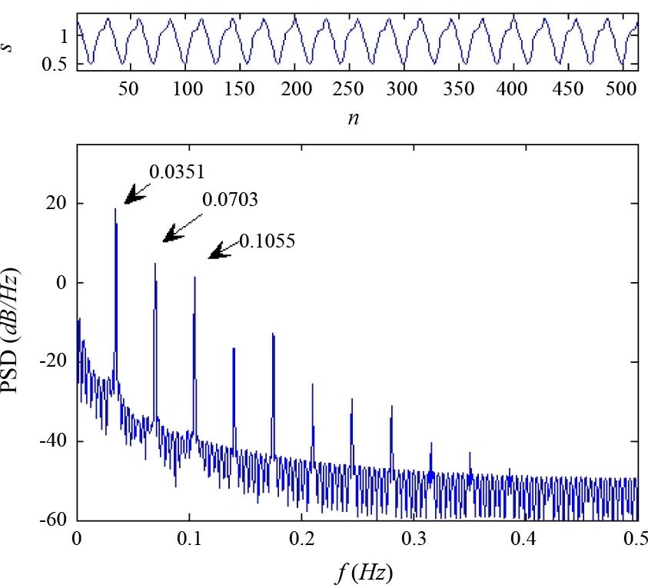
Spectral Plot
Notes:
https://www.researchgate.net/figure/An-example-of-Mackey-Glass-time-series-obtained-from-18-To-plot-the-discrete-MG-time_fig5_224151161

Slide 12
Identifying p and q
After the time series is stationary, you must identify the order of the AR and MA models. As you learned in Lesson 4, you can do this by looking at the following:
Autocorrelation plot
Partial autocorrelation plot

Slide 13
AR(p)
How do you determine the order p of the AR model?
Plot 95% confidence interval on the partial autocorrelation plot. (Most modern software does this automatically.)
Choose lag p such that partial autocorrelation becomes statistically zero for p+1 and beyond.

Slide 14
MA(q)
How do you determine the order q of the MA model?
Plot 95% confidence interval on the autocorrelation plot. (Most modern software does this automatically.)
Choose lag q such that autocorrelation becomes statistically zero for q+1 and beyond.

Slide 15
Guidelines

Slide 16
ARMA Model Estimation
Estimating the parameters of an ARMA model can be a complicated, nonlinear problem.
Nonlinear least squares and maximum likelihood estimation (MLE) are common approaches.
Many modern software programs will fit the ARMA model for you.

Slide 17
ARMA Model Validation
How do you know if your ARMA model is any good?
The residuals will approximate a Gaussian distribution (aka white noise).
Otherwise, you’ll need to iterate to obtain a better model.

Slide 18
ARIMA & SARIMA Models

Slide 19
ARIMA Model
ARIMA stands for autoregressive integrated moving average. ARIMA models have three components:
AR model
Integrated component (more on this shortly)
MA model

Slide 20
ARIMA Model Details
There are a few things you should know about ARIMA models:
The ARIMA model is denoted ARIMA(p, d, q).
p is the order of the AR model.
d is the number of times to difference the data.
q is the order of the MA model.
p, d, and q are nonnegative integers.

Slide 21

Differencing
It turns out that differencing nonstationary time series data one or more times can make it stationary. That’s the integrated (I) component of ARIMA.
d is the number of times to perform a lag-1 difference on the data.
d=0: no differencing
d=1: difference once
d=2: difference twice
$$Y_{i}=Z_{i}−Z_{i−1}$$

Slide 22

SARIMA Model
SARIMA is short for seasonal ARIMA. This model is used to remove seasonal components.
The SARIMA model is denoted SARIMA(p, d, q)(P, D, Q).
P, D, and Q represent the same as p, d, and q but they are applied across a season (for example, yearly).
M = one season
$$Y_{i}=Z_{i}−Z_{i−M}$$

Slide 23
Choosing ARIMA/SARIMA Parameters
How do you choose p, d, q and P, D, Q?
Visually inspect a run sequence plot for trend and seasonality.
Generate an ACF Plot.
Generate a PACF Plot.
Rule of thumb: p + q ≤ 3.

Slide 24
Automated Selection
Some modern software automatically selects model parameters for you.
The software tests a wide range and combination of parameters.
An optimization metric is used to determine the optimal combination.
Beware that different software implementations may provide a different selection of parameters due to the way the algorithms are implemented under the hood.

Slide 25
ARIMA Summary
Here’s what you should have learned about ARIMA:
Flexible family of models that capture autocorrelation.
Based on strong statistical foundation.
Requires stationary time series.
Choosing optimal parameters manually requires care.
Some software finds parameters automatically.
Can be challenging to explain and interpret.
Can be prone to overfitting.

Slide 26
Model Assumptions

Slide 27
Assumptions
ARMA, ARIMA, SARIMA assumptions:
Time-series data is stationary.
If nonstationary, remove trend, seasonality, apply differencing, and so on.
Remember that stationary data has no trend, seasonality, constant mean, and constant variance.
Therefore, the past is assumed to represent what will happen in the future in a probabilistic sense.

Slide 28
Applications in Python

Slide 29
Use Python to Fit ARMA, ARIMA, and SARIMA Models
Next up is a look at applying these concepts in Python.
See notebook entitled ARIMA_SARIMA_student.ipynb

Slide 30
Learning Objectives Recap
In this session you have done the following:
Reviewed key ideas from previous lessons.
Learned about the ARMA model and its stages.
Learned what the ARIMA and SARIMA models are and how to choose parameters.
Saw ARMA, ARIMA, and SARIMA model assumptions.
Used Python to construct ARMA, ARIMA, and SARIMA models.

Slide 31
Legal Notices and Disclaimers
This presentation is for informational purposes only. INTEL MAKES NO WARRANTIES, EXPRESS OR IMPLIED, IN THIS SUMMARY.
Intel technologies’ features and benefits depend on system configuration and may require enabled hardware, software or service activation. Performance varies depending on system configuration. Check with your system manufacturer or retailer or learn more at intel.com.
Sample source code is released under the Intel Sample Source Code License Agreement.
Intel, the Intel logo, the Intel. Experience What’s Inside logo, and Intel. Experience What’s Inside are trademarks of Intel Corporation in the U.S. and/or other countries.
*Other names and brands may be claimed as the property of others.
Copyright © 2018, Intel Corporation. All rights reserved.

